Slide 1
How to help people with disabilities
Melissa Miller

Slide 2
Types of Disabilities
Autism
Asperger's syndrome
Down Syndrome
Eclipsy
Fragile X
Physical disabilities: cannot walk: need a wheelchair, blind, deaf, mute etc.
The correct term to refer to people with learning disabilities is IDD (Intellectual Developmental Disability)

Slide 3
Why am I here today?

Slide 4
Why am I here today?

Slide 5
Brief History of Disabled People
The first ever recorded case of Autism was made in 1800, the disorder has believed to occurred for centuries.
People tended to sterotype Autistic People as people who sit in a corner, unable to speak, who rock, bang their heads on the floor, have tantrums and don't want to mix with others is also inaccurate. This stereotype is as misunderstood as people with Autism often are. There are individuals with Autism who want to make contact with other human beings but don't know how to, because they don't understand the basic, but contradictory rules which govern social interaction. Autistic people, if they can't speak, can't tell people to go away when they feel overloaded or overwhelmed, so they rock or behave in other repetitive beahaviors instead.
Battle against centuries of biased assumptions, harmful stereotypes, and irrational fears. The stigmatization of disability resulted in the social and economic marginalization of generations of Americans with disabilities, and like many other oppressed minorities, left people with disabilities in a severe state of impoverishment for centuries.

Slide 6
Brief History of Disabled People cont.
People with disabilities were also forced to enter institutions and asylums, where many spent their entire lives. The “purification” and segregation of persons with disability were considered merciful actions, but ultimately served to keep people with disabilities invisible and hidden from a fearful and biased society.
Many disabled people have made a difference in society
-President Franklin Delano Roosevelt, the first president with a disability, was a great advocate for the rehabilitation of people with disabilities, but still operated under the notion that a disability was an abnormal, shameful condition, and should be medically cured or fixed.
-Helen Keller was born blind and deaf; In 1915 she and George Kessler founded the Helen Keller International (HKI) organization. This organization is devoted to research in vision, health and nutrition.
-Christopher Reeves (actor)(who suffered a horrible horse riding accident) left him paralyzed from the neck down; him and his wife Dana created the Christopher and Dana Reeves Foundation to help people who were either born or accidently got paralyzed
-Michael J. Fox (Back to the Future) has Parkinson’s disease, founded his own fountation to help people with Parkison’s disease
-Jim Sinclair (Autism Rights Activist, born with Autism) formed Autism Network International in 1992

Slide 7
Activism
1940s and 1950s, disabled World War II veterans placed increasing pressure on government to provide them with rehabilitation and vocational training. World War II veterans made disability issues more visible to a country of thankful citizens who were concerned for the long-term welfare of young men who sacrificed their lives to secure the safety of the United States.
People with disabilities were barred from buildings, work places and were not allowed to apply for jobs.
1960s, the civil rights movement began to take shape, and disability advocates saw the opportunity to join forces alongside other minority groups to demand equal treatment, equal access and equal opportunity for people with disabilities. The struggle for disability rights has followed a similar pattern to many other civil rights movements – challenging negative attitudes and stereotypes, rallying for political and institutional change, and lobbying for the self-determination of a minority community.
Disability rights activists mobilized on the local level demanding national initiatives to address the physical and social barriers facing the disability community. Parent advocates were at the forefront, demanding that their children be taken out of institutions and asylums, and placed into schools where their children could have the opportunity to engage in society just like children who were not disabled.

Slide 8
Activism cont.
In the 1970s, disability rights activists lobbied Congress and marched on Washington to include civil rights language for people with disabilities into the 1972 Rehabilitation Act.
In 1973, the Rehabilitation Act was passed, and for the first time in history, civil rights of people with disabilities were protected by law. (Section 504) provided equal opportunity for employment within the federal government and in federally funded programs, prohibiting discrimination on the basis of either physical or mental disability. Section 504 of the Rehabilitation Act also established the Architectural and Transportation Barriers Compliance Board, mandating equal access to public services (such as public housing and public transportation services) to people with disabilities, and the allocation of money for vocational training.
In 1975, the Education for All Handicapped Children Act was passed to guarantee equal access to public education for children with disabilities. This act of legislation specified that every child had a right to education, and mandated the full inclusion of children with disabilities in mainstream education classes, unless a satisfactory level of education could not be achieved due to the nature of the child’s disability.
After decades of campaigning and lobbying, the Americans with Disabilities Act (ADA) was passed in 1990, and ensured the equal treatment and equal access of people with disabilities to employment opportunities and to public accommodations. The ADA intended to prohibit discrimination on the basis of disability in: employment, services rendered by state and local governments, places of public accommodation, transportation, and telecommunications services.
deep-rooted assumptions and stereotypical biases were not instantly transformed with the stroke of a pen. People with disabilities still face prejudice and bias with the stereotypical portrayal of people with disabilities in the movies and in the media, physical barriers to schools, housing and to voting stations, and lack of affordable health care. The promise of the ADA is yet to be fully realized, but the disability rights movement continues to make great strides towards the empowerment and self-determination of Americans with disabilities.

Slide 9
Brief summary of Autism
It is a mental disability that is genetic.
Unfortuntely there is no cure, but there is Autism research that is going on today
There is a spectrum (mild: less servere, moderately: more severe and severely bad: serious Autism which can cause obessive rocking, lack of emotions, abnormal brain, cannot speak, lack of social cues)

Slide 10
More on Autism
Sensory experiences that parents don't even notice may be extremely frightening or unpleasant for a child - the feel of a certain fabric, sounds of certain frequency, particular colors or seemingly bland foods.
The child's reactions can easily be interpreted as wilful misbehavior. Along with this will frequently be difficulties in movement, coordination and sensing where one's body is in a given space, leading to clumsiness and difficulty with tasks such as dressing.
People with Autism may be overly sensitive to certain textures, sounds, smells, and tastes. Wearing certain fabrics, tasting certain foods, or normal everyday sounds may cause emotional outbursts
May feel little pain or actually enjoy sensations we would dislike: Strong smells,

Slide 11
Brief Summary of Asperger’s Syndrome
Asperger's syndrome, also called Asperger's disorder, is a type of pervasive developmental disorder (PDD). PDDs are a group of conditions that involve delays in the development of many basic skills, most notably the ability to socialize with others, to communicate, and to use imagination.
Children with Asperger's syndrome typically function better than do those with autism. In addition, children with Asperger's syndrome generally have normal intelligence and near-normal language development, although they may develop problems communicating as they get older.

Slide 12
Brief Summary of Down Syndrome
Down syndrome occurs genetically when a child gets an extra chromosome 21 — for a total of 47 chromosomes instead of 46 from both parents. It's this extra genetic material that causes the physical features and developmental delays associated with DS.
Although no one knows for sure why DS occurs and there's no way to prevent the chromosomal error that causes it, scientists do know that women age 35 and older have a significantly higher risk of having a child with the condition.
Down Syndrome was named after John Langdon Down who first described the condition in 1887. It was not until 1959 when French phyiscan Doctor Jerome Lejune that the extra chromosomes was discovered that caused Down Syndrome.
Physical features such as a flat facial profile, an upward slant to the eyes, small ears, and a protruding tongue.

Slide 13
Down Syndrome Summary cont.
Low muscle tone (called hypotonia) is also characteristic of children with DS, and babies in particular may seem especially "floppy.“
Kids with Down Syndrome tend grow at a slower rate and remain smaller than their friends.
Most have mild to moderate intellectual impairment. Kids with DS can and do learn, and are capable of developing skills throughout their lives. They simply reach goals at a different pace — which is why it's important not to compare a child with DS against typically developing siblings or even other children with the condition.
Kids with DS have a wide range of abilities, and there's no way to tell at birth what they will be capable of as they grow up.
Kids with DS also have heart problems and an increased risk of developing pulmonary hypertension which is a serious condition that can lead to irreversible damage to the lungs.

Slide 14
Fragile X
Fragile X syndrome is a genetic condition that causes a range of developmental problems including learning disabilities and cognitive impairment. Usually, males are more severely affected by this disorder than females.
Affected individuals usually have delayed development of speech and language by age 2. Most males with fragile X syndrome have mild to moderate intellectual disability, while about one-third of affected females are intellectually disabled.
Children with fragile X syndrome may also have anxiety and hyperactive behaviors including fidgeting or impulsive actions. They may have attention deficit disorder (ADD), which includes an impaired ability to maintain attention and difficulty focusing on specific tasks.

Slide 15
Fragile X cont.
About one-third of individuals with fragile X syndrome have features of autism spectrum disorders that affect communication and social interaction. Seizures occur in about 15 percent of males and about 5 percent of females with fragile X syndrome.
Physical characteristic features become more apparent with age.
Some of these features include a long and narrow face, large ears, a prominent jaw and forehead, unusually flexible fingers, flat feet, and in males, enlarged testicles (macroorchidism) after puberty.
Fragile X syndrome is inherited in an X-linked dominant pattern. A condition is considered X-linked if the mutated gene that causes the disorder is located on the X chromosome, one of the two sex chromosomes. (The Y chromosome is the other sex chromosome.)

Slide 16
Suffolk Downs: Walk for Autism 2010

Slide 17
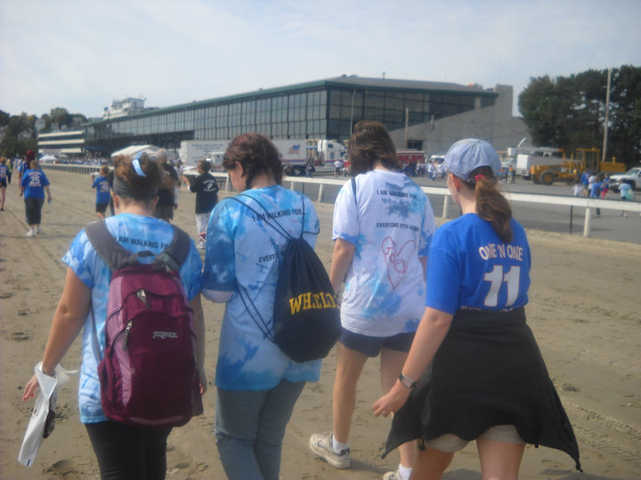
Walking with my friend and her college friends

Slide 18
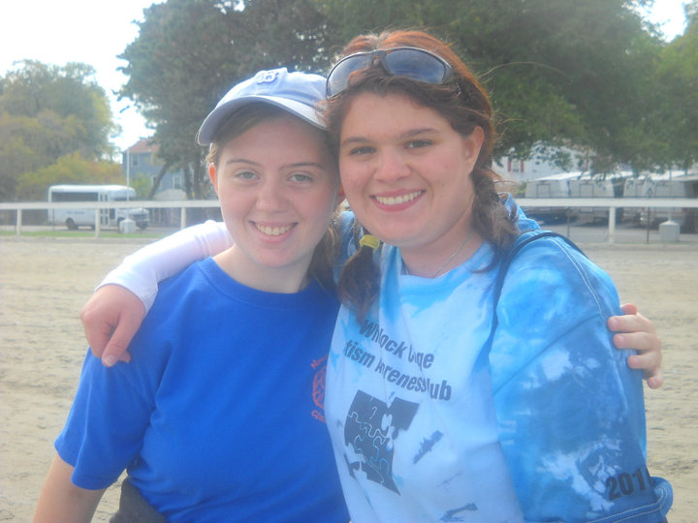
My friend and I

Slide 19
How can I get involved?
Join or create a Best Buddies club at your school (also college/university as well when you begin your semester)
Reach out to organizations like Alternatives and Seven Hills (both in Worcester) to find buddies and get involved.
Join Autism Speaks (and other activism websites) and get emailed updates
Go on the Walk for Autism (there is one in Suffolk Downs and another in Worcester)
Donate to Autism Speaks and the Autism Resource Center in Worcester
Form a Unified Sports club at your school (Unified Sports is part of Special Olympics) or Volunteer at Special Olympics games

Slide 20
How can I get involved cont.
Volunteer at Camps with both physically and mentally disabled children
Become a Scientist to help find cures
Work in Inclusion programs at Schools, (believe me, we need all of the inclusion teachers/ teaching assistants we can get)
Learn Sign Language to communicate with them
Become a psychologist
Read books about people with mental and physical disabilities: children book called Mockingbird, and it is by Kathryn Erskine (or something close to that). Great book! (Funny and sad and touching and thought-provoking).
Run for Congress or President to raise public awareness of these disabilities and get more people involved as well as combatting the sterotypes against them
Best Buddies Challenge
Advocacy (Socialist groups)

Slide 21
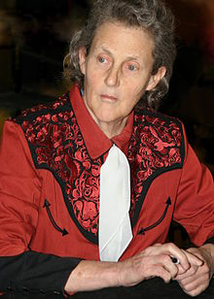
Movies that are recommened to watch
The elephant Man
Edward Scissorhands
The Boy who could Fly
Hundback of Northdame
The King’s Speech
Miracle Worker (Anne Sullivan’s story about Helen Keller who was blind and deaf)
Ray (singer Ray Charles who was blind)
Mercury Rising
What is eating Gilbert Grape?
Forrest Gump
Educating Peter
Graduating Peter
Temple Grandin

Slide 22
Video Clips
http://www.youtube.com/watch?v=gHl3HdcVN3k
http://www.youtube.com/watch?v=9QTDaI3OoRY
http://www.youtube.com/watch?v=tvKzyYy6qvY&list=PL8484CEBA4AF0F209
https://www.youtube.com/watch?v=YeWks6cgJ-k

Slide 23
College Majors that can be used to help disabled people
Chemistry
Biology
Education
Psychology
Sociology
Physics

Slide 24
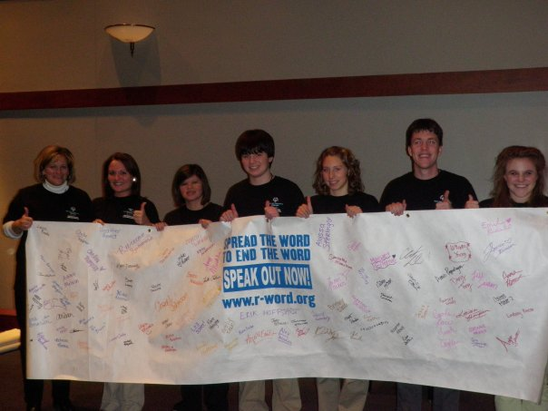
Spread the word to end the R word

Slide 25
You can Make a Difference
Making a difference to helping these disabled people will not help them become recongized
You will be taking action from the goodness of your heart

